Slide 1
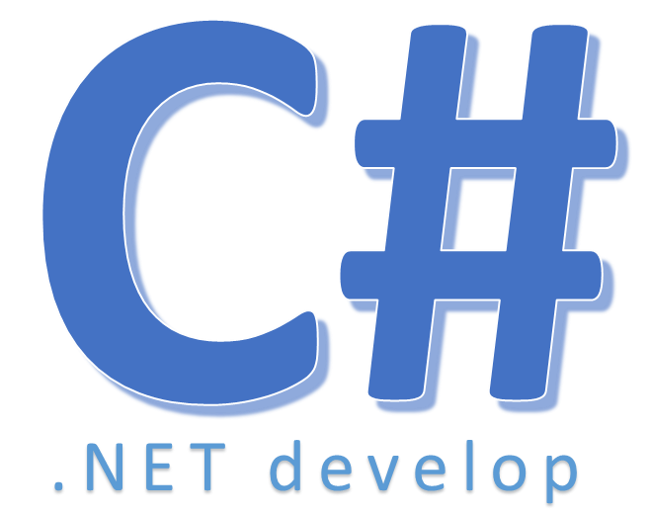

Implicitly Typed Variables

Slide 2
Nội dung
– Declare variables without specifying their type
– Strongly type, not variant, not object
– Visual Studio will determine type
• Predict what the compiler will choose
• Intelligence support
– Type inference -> most general
• “3/10/2010” -> string, not date
Notes:
- kiểu dữ liệu nội suy

Slide 3
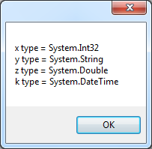
Nội dung
private void button2_Click(object sender, EventArgs e)
{ var x = 113;
var y = "1/1/2012";
var z = 1.7;
var k = new DateTime(2012, 1, 1);
string msg = "x type="+x.GetType() + "\n"+
"y type = "+y.GetType() + "\n" +
"z type ="+z.GetType() + "\n" +
"k type = " + k.GetType();
MessageBox.Show(msg);
}

Slide 4
Nội dung
– Always declare the type if we know
– Implicitly Typed Variables are suited for LINQ and anonymous type
Must init value when declare
Can not change data type
Can not use as variable parameter

Slide 5


Hey! Coding is easy!
END

